Slide 1

Preparing Research Proposals: Tips for Improving Chances of Success
Dr SK Varshney
Former Head, International Cooperation, Department of Science & Technology

Slide 2
Estimated Success rates of research projects
ANRF – NPDF < 7%
ANRF – PMECRG - < 8%
ANRF – ARG - < 5%
ANRF – IRG – 20%
BIRAC – 8%
CSIR NMITLI - 4%
SBIRI – 10%
JRF NET – 3-5%
JEE - < 1% for IIT and < 1.08% for NIT
Projects in Targeted Areas – 10%
Overall success ~ 7%

Slide 3
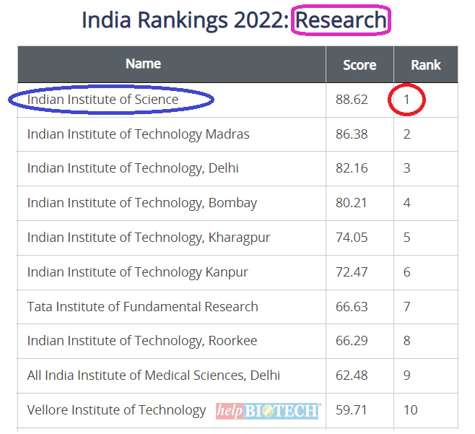
The Lion’s share

Slide 4
Is poor success rate – reason to worry?
No, but we need a better approach to project.

Slide 5
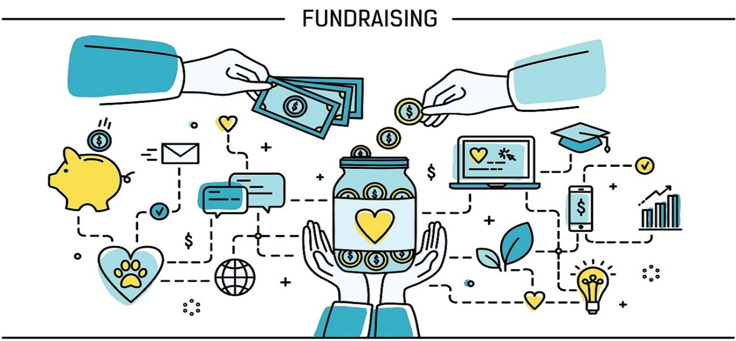
Why should any agency fund your idea

Slide 6
Decision Path
1st Stage – Scrutiny
2nd stage - Refereeing
3rd Stage – Reviewing
4th stage – Administrative Processing

Slide 7
Scrutiny of proposals
All prescribed procedures followed, guidelines met
Plagiarism and AI content
Track record of PI and Co-PIs
Several portals may indicate if it has gone through initial screening
Filtered proposals go for refereeing

Slide 8


Understand the dynamics of peer review:
Referees/ Reviewers will assess many applications
Make your application easy to read and easy to understand
The impact and significance should be clear throughout the application
Convince them to be your advocate
Get them on your side!

Slide 9

Interest at first sight
Clear title
Sharp Abstract/Objectives
Logical methodology
Nice Illustrations
Good organisation of thoughts
Call Objectives

Slide 10
Scientific and methodological soundness
Originality and contribution: Is the research novel? Does it address an important gap in the literature? Does it make a significant contribution to the field?
Methodology: Is the research design appropriate and rigorous? Are the methods clearly described, detailed enough for replication, and correctly applied?
Data and analysis: Was the correct data used and analyzed appropriately? Are the statistical and other tests valid and powerful?
Expected outcomes: Are they clearly planned? Generation of Knowledge, development of a product or service to the society at large.

Slide 11
Type of Research
Societal Research
Industrial
Research
Basic Research

Slide 12
Features of A Good Proposal
Scientific Novelty and Innovation
Simple Language
Relevance to Society/ Challenges
Demonstrated Competence/expertise of PI
Feasibility Study
Time Schedule
Enthusiasm
Complete Literature
Deliverables

Slide 13
Scientific Novelty
Originality of thought – Sharp objectives
Need for Such a Project
Research Gap Area
Purpose of the Research
How innovative you are?
Are you trying to replace an existing product / process?

Slide 14


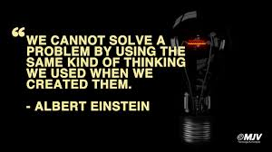
Innovation Selection of Project Idea

Slide 15

Key Element Idea: Identification of Problem
How will you implement it ?
Can you convert your idea/ thought into workable model?
Able to explain to others ?

Slide 16

Critical parameters: 1. Why this project

Slide 17
Critical parameter: 2. Why you?
Do you understand the proposed subject?
Have you done some previous work in that domain?
Do you have some credits?
What kind of researcher you are?
Will you be able to complete the project with your own research strength and resources available to you?

Slide 18
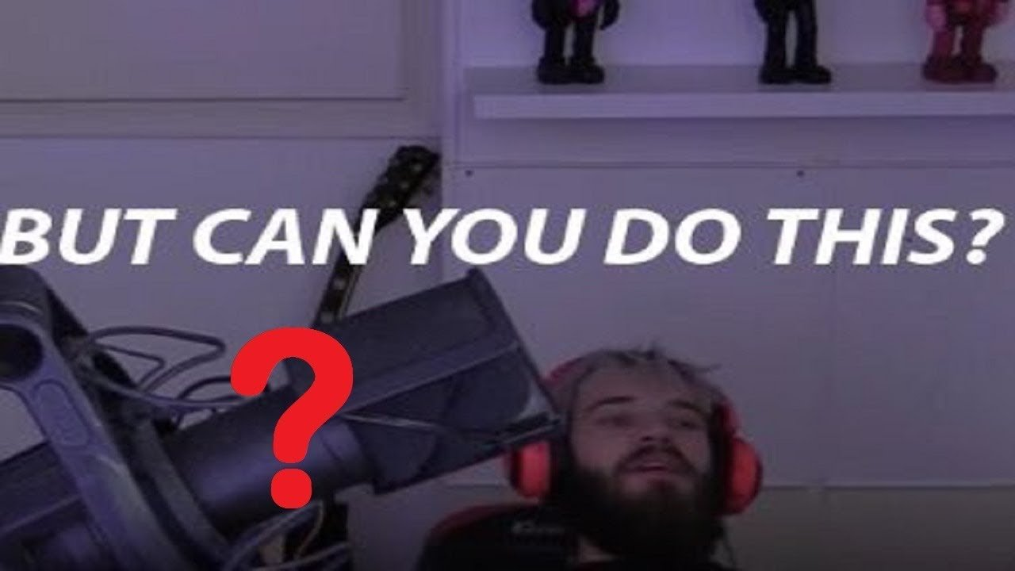
Critical Parameter 3: Can you do it?

Slide 19
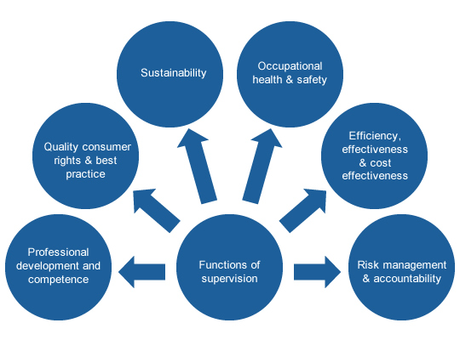
Critical parameter 4: Professional Approach

Slide 20
Structure and Presentation
Clarity and organization: Is the proposal well-written, clear, concise, and easy to understand?
Literature review: Is the existing literature review thorough and relevant?
References: Are the references appropriate, up-to-date, and of good quality?
Scope: Does the manuscript fit the scope of the call for proposals?

Slide 21

Formatting/ Design
Use page numbers, headers, and footers
Include photos and diagrams
Make sure the proposal looks professional

Slide 22
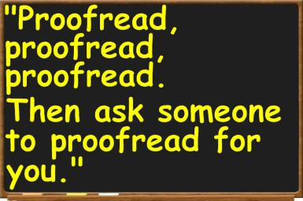

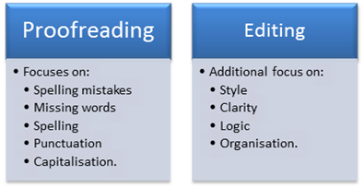

Slide 23
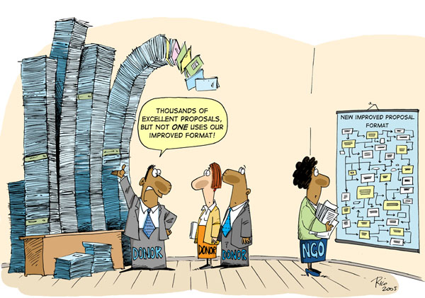
Right Format ?

Slide 24

Critical parameter 5: USP

Slide 25
Required documents
Forwarded by Head of the Institute.
Consent by participating institutes.
Consent by institutes whose facilities are going to be used.
Ethical / bio-safety / clinical committee clearances, if need be

Slide 26
How Funding agencies see it
Referees give qualitative opinions and quantitative assessment.
Normally, odd number of referees are invited.
Is there a major or minor difference in rating of various referees?
Funding agency may seek additional comments

Slide 27
Typical Scoring Questions
Parameter | Rating 1-10 or 1-100
Project Objectives
Scientific Novelty
Methodology
Project Narratives or Purposefulness
Social, Industrial or SDG implications
Personal strength of the PI and team
Availability of Infrastructure Resources
Is project ready to be implemented or requires clearances / permissions
Targeted outcomes
Necessity of collaboration
Minor Incentives (Geography, Gender)

Slide 28

Competitiveness….
All proposals do not get accepted!
One needs to score on each aspect.
Make the project more purposeful.
Be Self Critical!
NEVER GIVE UP!
….try & try until you succeed!

Slide 29
Few Suggestions

Slide 30
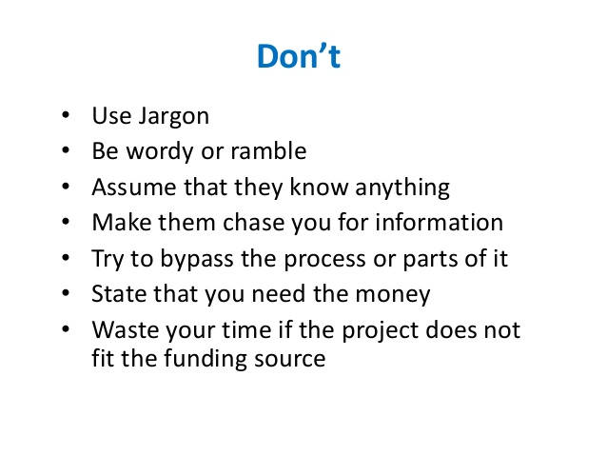
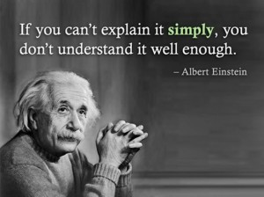
Writing Tips
Be concise
Avoid superfluous words or phrases
Use the active voice, not the passive voice

Slide 31
Pitfalls To Avoid in Writing The Proposal
Being too ambitious in your projects
Using generalities
Assuming readers/ reviewers know your capabilities
Hiding/hidden costs (intentional/unintentional)
Sending the proposal in at the last minute
Failing to revise and resubmit the proposal

Slide 32
Be ambitious but realistic….
Proposals assessed based on your proven abilities
NGO working in Science Communication proposing molecular biology proposal is unrealistic
If heading into newer territory, do preliminary work first to have “Proof of Concept”

Slide 33

Be focused and specific
Show how your project is related to the grant giver’s goals
Provide details, including the justified budget
Include everything required by the Request For Proposal (RFP)
Define terms
Be succinct/concise
Allow time for revision
Get feedback from other people
Maintain your individuality.

Slide 34


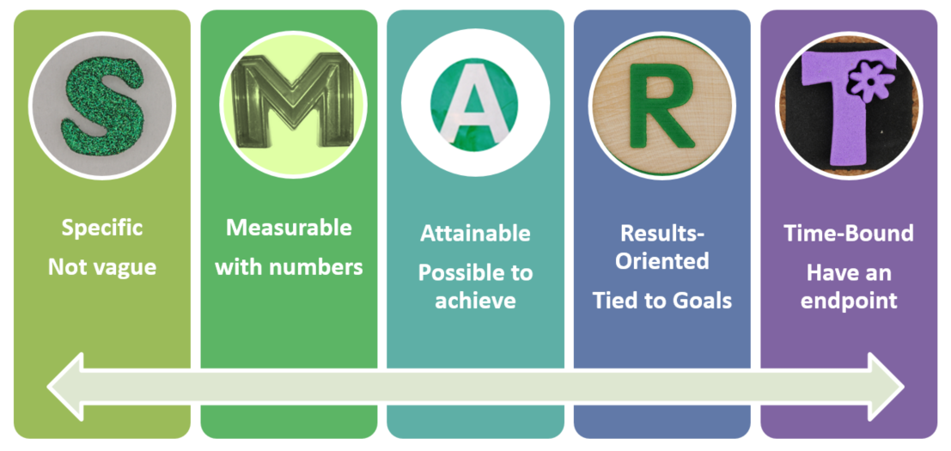

Slide 35
Methodology
Should be well defined in step wise manner
No need of detail description about experiments but NEED outline
Prepare and attach preliminary questionnaire, if required
Content and Target beneficiaries, if training/ workshop proposed

Slide 36
Budget Strategy
Ask for what you need to do the work.
Justify requests that are significant in line of your Objectives
Imagine what your project needs to make it a reality.
Follow sponsor and institutional guidelines and policies.
Try to collect Quotations for Equipments before quote
When in doubt, ask!
Reviewers emphasize project quality over budget.

Slide 37
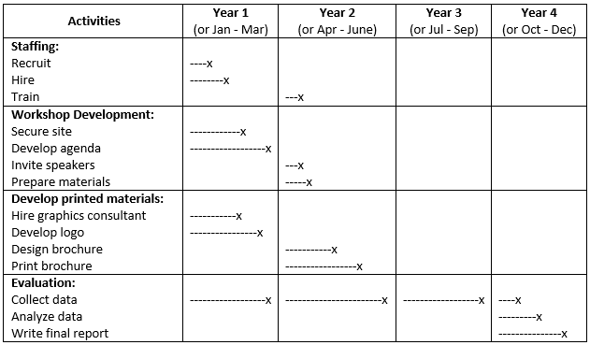
Time line

Slide 38
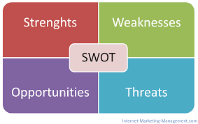

Slide 39



……finally

Slide 40


Discuss ideas with them before starting the writing
If possible, read his or her successful application
(but DO NOT COPY!)
Get feedback on your application/idea

Slide 41
If your proposal is rejected…
Don’t give up!
Get reviews
Talk to agency contact
Re-evaluate, revise and resubmit
Look for other potential funders

Slide 42

Top 10 Reasons for an Unsuccessful Proposal
1. Project doesn't address agency priorities
2. Guidelines not followed
3. Not a compelling idea
4. Ideas not clearly presented
5. Methodology appears to be flawed
6. Overuse of jargon
7. Overly ambitious
8. Narrative and budget don’t correspond
9. Bad presentation
10.Repetition of published work

Slide 43
Reviewers may or may not appreciate your idea.
Reviewers do not have conflict of interest. They simply provide an assessment
of material that you provided in your application.
Don’t take it personally!
Take it Professionally!!!!

Slide 44



Thank You
For any specific query
Please write to me at
skvdst@yahoo.com
s-k-varshney-5059b24/
skvdst
skvdst

